Slide 1

Customer Purchasing
Capabilities

Slide 2

Objectives
Good Design Solve Problem Something Gallery
Customer Segmentation is the subdivision of a market into discrete customer groups
that share similar characteristics. Customer Segmentation can be a powerful means to identify unsatisfied customer needs. Using the above data, companies can then outperform the competition by developing uniquely appealing products

Slide 3
BALANCE
BALANCE_FREQUENCY
PURCHASES
ONEOFF_PURCHASES
INSTALLMENTS_PURCHASES
CASH_ADVANCE
PURCHASES_FREQUENCY
ONEOFFPURCHASESFREQUENCY
PURCHASESINSTALLMENTSFREQUENCY
CASHADVANCEFREQUENCY
CASHADVANCETRX
PURCHASES_TRX
CREDIT_LIMIT
PAYMENTS
MINIMUM_PAYMENTS
PRCFULLPAYMENT
TENURE
Data sharing agreement

Slide 4
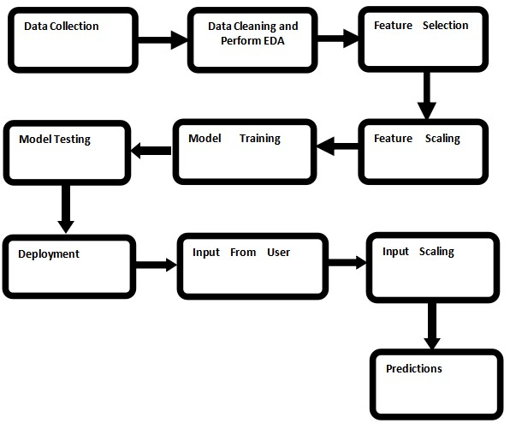
Architecture

Slide 5
Data Pre-processing
1.we cleaned our data by removing null values by removing them because they were very less in number.
2.we apply min-max scaling tle down data.
3.Then we perform principle component analysis
to create no of clusters and visualization purpose.

Slide 6
Model Training
we train our data on different unsupervised machine learning
algorithms and we get best performance with k-means clustering.

Slide 7
Q & A
Q1) What’s the source of data?
The data for training is taken from kaggle.
Q 2) What was the type of data?
The data was the combination of numerical and Categorical values.
Q 3) What’s the complete flow you followed in this Project?
Refer slide 4th for better Understanding

Slide 8
Q & A
How Prediction was done?
1.if prediction result is cluster 0,means customers purchasing capability is more.
2.if prediction result is cluster 1,means customer purchasing capability is partial.
3.if prediction result is 2,means customer purchasing capability is less.

Slide 9
Thank you

